Slide 2
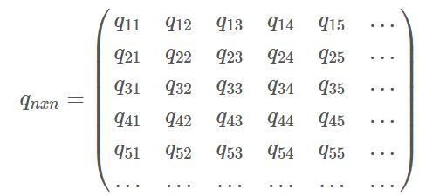
More species influenced by technologies
More relevant technologies

